Slide 1
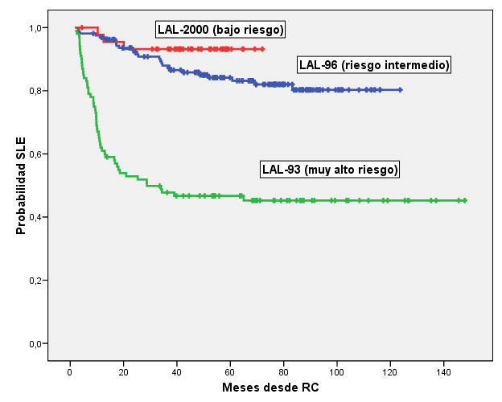
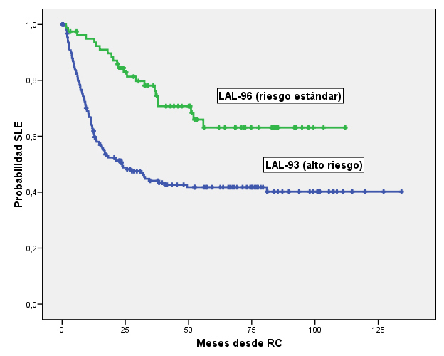
La LAL del adulto tiene mal pronóstico
PETHEMA LAL infantil
PETHEMA LAL Adulto
25%
15%

Slide 2
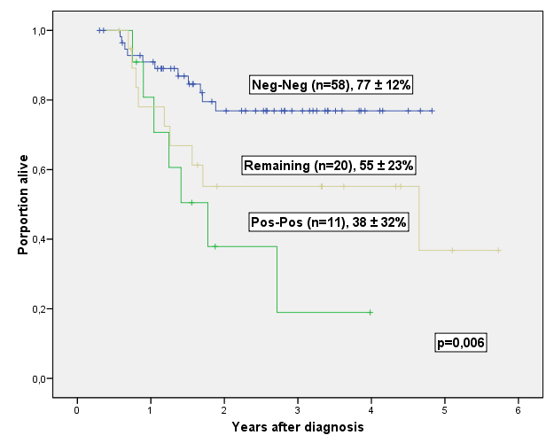
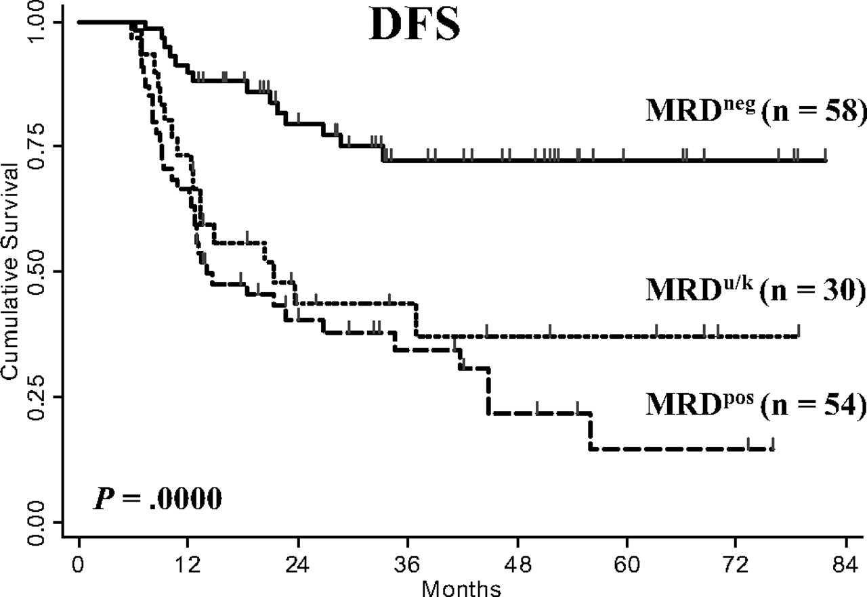
Aclaramiento ER y pronóstico en LAL adulto
Bassan R, et al. Blood 2009; 113: 4153-4162
JM Ribera et al, ASH 2009, oral presentation

Slide 3
LAL riesgo estándar
Edad <30 a, leucocitos <30x10⁹/L, no t(9;22), no t(4;11)
Respuesta estándar al tratamiento
Protocolos de base pediátrica

Slide 4
AL in AYA. Retrospective comparative studies
“Pediatric” vs “adult” treatments
Country Protocol Age N CR(%) 5yr.EFS(%)
USA CCG(P) 16-21 197 96 64
CALGB(A) 16-21 124 93 38
France FRALLE93(P) 15-20 77 94 67
LALA94 (A) 15-20 100 83 41
Holland DCOG (P) 15-18 47 98 69
HOVON (A) 15-20 44 91 34
UK ALL97 (P) 15-17 61 98 66
UKALLXII(A) 67 94 49
Italy AIEOP (P) 14-18 150 94 80
GIMEMA (A) 95 89 71(2yr)
Sweden NOPHO-92(P) 10-18 144 99 66
Adult (A) 15-25 99 90 42
Finland NOPHO (P) 10-25 128 96 67
ALL (A) 97 97 60
Reviewed in: Ribera JM. Hematol Oncol Clin North Am 2009; 23:1033-42

Slide 5
Major differences in pediatric vs. adult protocols
Higher dose of essential drugs
  Up to 3x vinca alkaloids
  Up to 5x prednisolone
  Up to 20x asparaginase
Less use of myelosuppressive drugs
  eg, anthracyclines, cyclophosphamide, cytarabine
Less use of BMT
  BMT only recommended by pediatricians for very high-risk ALL
Less delays between therapy elements
  Time to treatment following initial CR was 2 days in pediatric practice vs. 7 days in adult practice (P = .002)
Notes:
ALL, acute lymphoblastic leukemia; BMT, bone marrow transplantation; Ph+, Philadelphia chromosome positive.
So, what are the differences between pediatric and adult protocols? Most pediatric approaches use more of the intensive nonmyelosuppressive drugs, using up to 3 times more vinca alkaloid, much more steroid, and, most importantly, up to 20 times more asparaginase than typical adult protocols. In addition, there is much less use of myelosuppressive drugs, for example anthracyclines, cyclophosphamide, and cytarabine. Pediatric protocols also make less use of allogeneic bone marrow transplantation; however, bone marrow transplantation is still recommended by pediatricians for very high-risk ALL.

Slide 6
Prospective studies on therapy of ALL in AYA
Group-Protocol Age N CR(%) EFS (%)
DFCI 91-01,95-01 15-18 51 94 78
GRAALL-03* 15-45 172 95 58
PETHEMA ALL96** 15-18 35 94 60
19-30 46 100 63
DFCI 18-50 74 82 72
Toronto-Modified DFCI 18-60 85 89 71
FRALLE 93 HR-derived*** 18-55 40 90 72 (OS)
Toronto-Modified DFCI**** 17-64 32 84 83 (OS)
*Increase of 8.6-fold, 3.7-fold and 16-fold in cumulated doses of PDN, VCR and L-ASP compared to ALL-94 protocol. Better results in patients up to 45 yr
** No differences between adolescents and young adults
***Better results in patients up to 40 yr
**** Only T-ALL
Reviewed in: Ribera JM. Hematol Oncol Clin North Am 2009; 23:1033-42

Slide 7
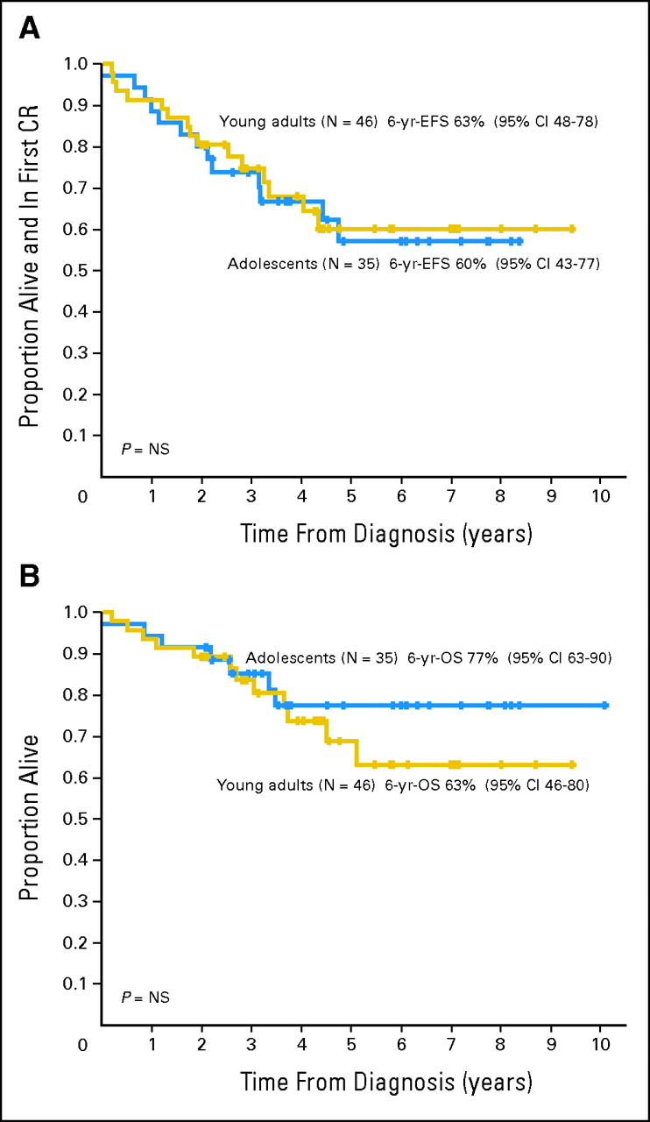
PETHEMA ALL-96
Adolescents 15-18 yr.
Young adults: 19-30 yr.
Ribera, JM. et al. J Clin Oncol 2008; 26:1843-1849

Slide 8
LAL riesgo estándar. PETHEMA RI-08

Slide 9
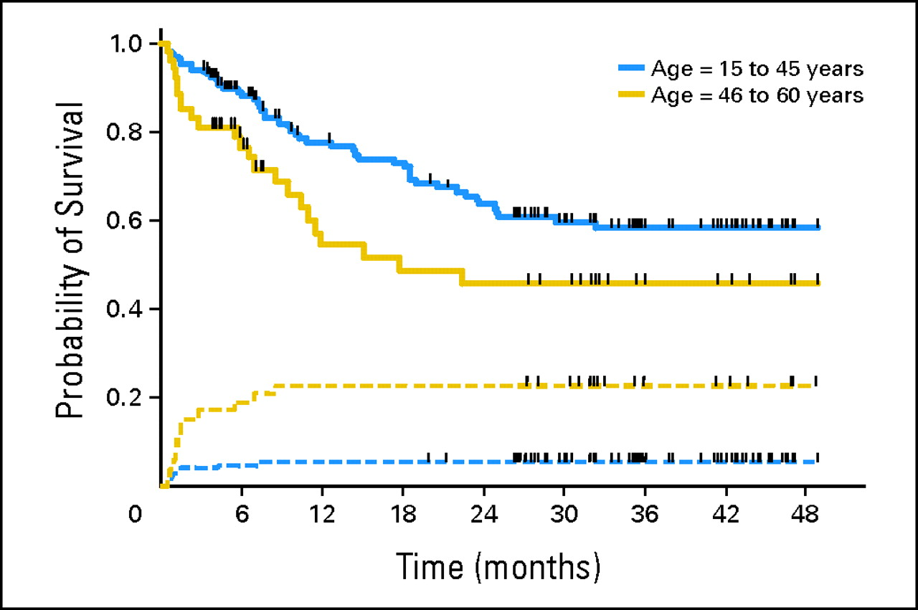
How far can we go with pediatric protocols?
Huguet, F. et al. J Clin Oncol; 27:911-918 2009

Slide 10
LAL riesgo elevado, Ph-negativa
Edad >30 a, leucocitos >30x10⁹/L, t(4;11)
Respuesta lenta al tratamiento
Quimioterapia
Trasplante progenitores hematopoyéticos

Slide 11
Results of adult ALL trials: induction therapy
Study Year n Age Drugs CR rate
GMALL 02/84 1993 562 28 V,P,A,D,C, AC,M,MP 75%
FGTALL 1993 572 n.r. V,P,D/R,C, [AM,AC] 76%
MRC XA 1997 618 >15 V,P,A,D 82%
PETHEMA 1998 108 20 V,P,D,A,C 86%
CALGB 1998 198 35 V,P,D,A,C 85%
MDACC 2000 204 39 V,DX,A,D,C 91%
GMALL 05/93 2001 1163 35 V,P,D,A,C,AC,MP 83%
Lombardia 2001 121 35 V,P,A,[C] 84%
Sweden 2002 153 42 V,BX, HDAC,C,D,AM 86%
GIMEMA 2002 794 28 V,P,A,D,C [HDAC,Mi] 82%
PETHEMA/ALL-93 2005 222 27 V,P,D,A,C 82%
MRC/ECOG 2005 1521 <35 V,P,A,D,C,AC,MP 91%
6236 84%

Slide 12
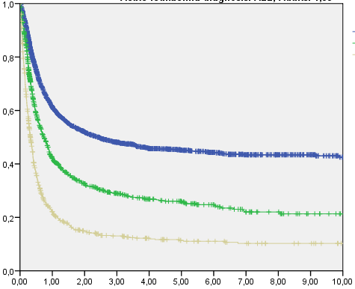
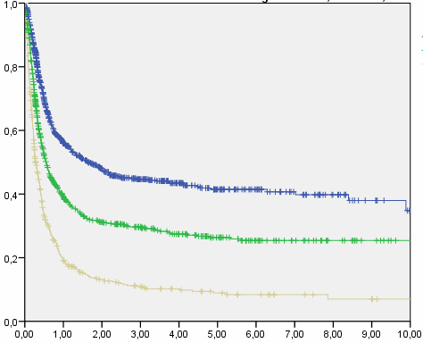
Outcome after alloHSCT from for ALL: ALWP registry 1994 - 2008
HLA-identical sibling (N=4687)
Matched unrelated donor (N=2332)
CHILDREN ALL (n=2126)
ADULT ALL (n=4687)
45+/-1
CR1 (2739)
41+/-2
CR1 (1000)
26+/-2
CR2 (1023)
26+/-2
CR2 (784)
11+/-1
ADV (925)
9+/-1
ADV (548)
Notes:
12

Slide 13
Probability of Survival after Unrelated Donor Transplants for ALL, 1998-2004
- by Age and Disease Status -
100
100
80
80
60
60
Probability, %
CR1 <20 (N=466)
40
CR1 20+ (N=519)
40
CR2+ <20 (N=380)
20
CR2+ 20+ (N=1,221)
20
Advanced <20(N=244)
P < 0.001
P < 0.001
Advanced 20+(N=392)
0
0
1
1
3
0
3
0
2
2
4
4
5
5
6
6
Years
CIBMTR data
Notes:
ALL, acute lymphocytic leukemia; CR, complete remission.
For ALL, the same pattern occurs, such that unrelated donor transplantations have slightly worse survival for each stage of disease examined.

Slide 14
Adjusted Leukemia-Free Survival an relapse in ALL
Ringden O, et al. Blood. 2009;113:3110-3118
Notes:
Slide/Clip 16
ALL, acute lymphocytic leukemia; HLA, human leukocyte antigen.
The same concept applies to ALL; unrelated and matched sibling transplantations no longer show any apparent difference in leukemia-free survival vs HLA-identical sibling transplantations (relative risk = 1.05; nonsignificant P value).

Slide 15
Role of alloHSCT for adult ALL in CR1: comparative prospective studies (donor vs. no donor)
Study n Population DFS Surv
LALA-87 116 vs 141 Adult ALL 45 vs 31% 48 vs 35%
in high-risk ALL 39 vs 14% 44 vs. 11%
JALSG-93 34 vs 108 Adult ALL NR 46 vs 40%
LALA-94 100 vs 159 High-risk ALL 45 vs 23% 51 vs 33%
GOELAL02 41 vs 106 High-risk ALL 75 vs 40% 75 vs 33%
EORTC 68 vs 116 Adult ALL 38 vs 36% 41 vs 39%
PETHEMA 84 vs 98 High-risk ALL 40 vs 49% 37 vs 46%
MRC/ECOG 443 vs 558 Adult ALL 50 vs 41% 53 vs 45%
in high-risk ALL 38 vs 32% 41 vs. 35%
: allo > control

Slide 16
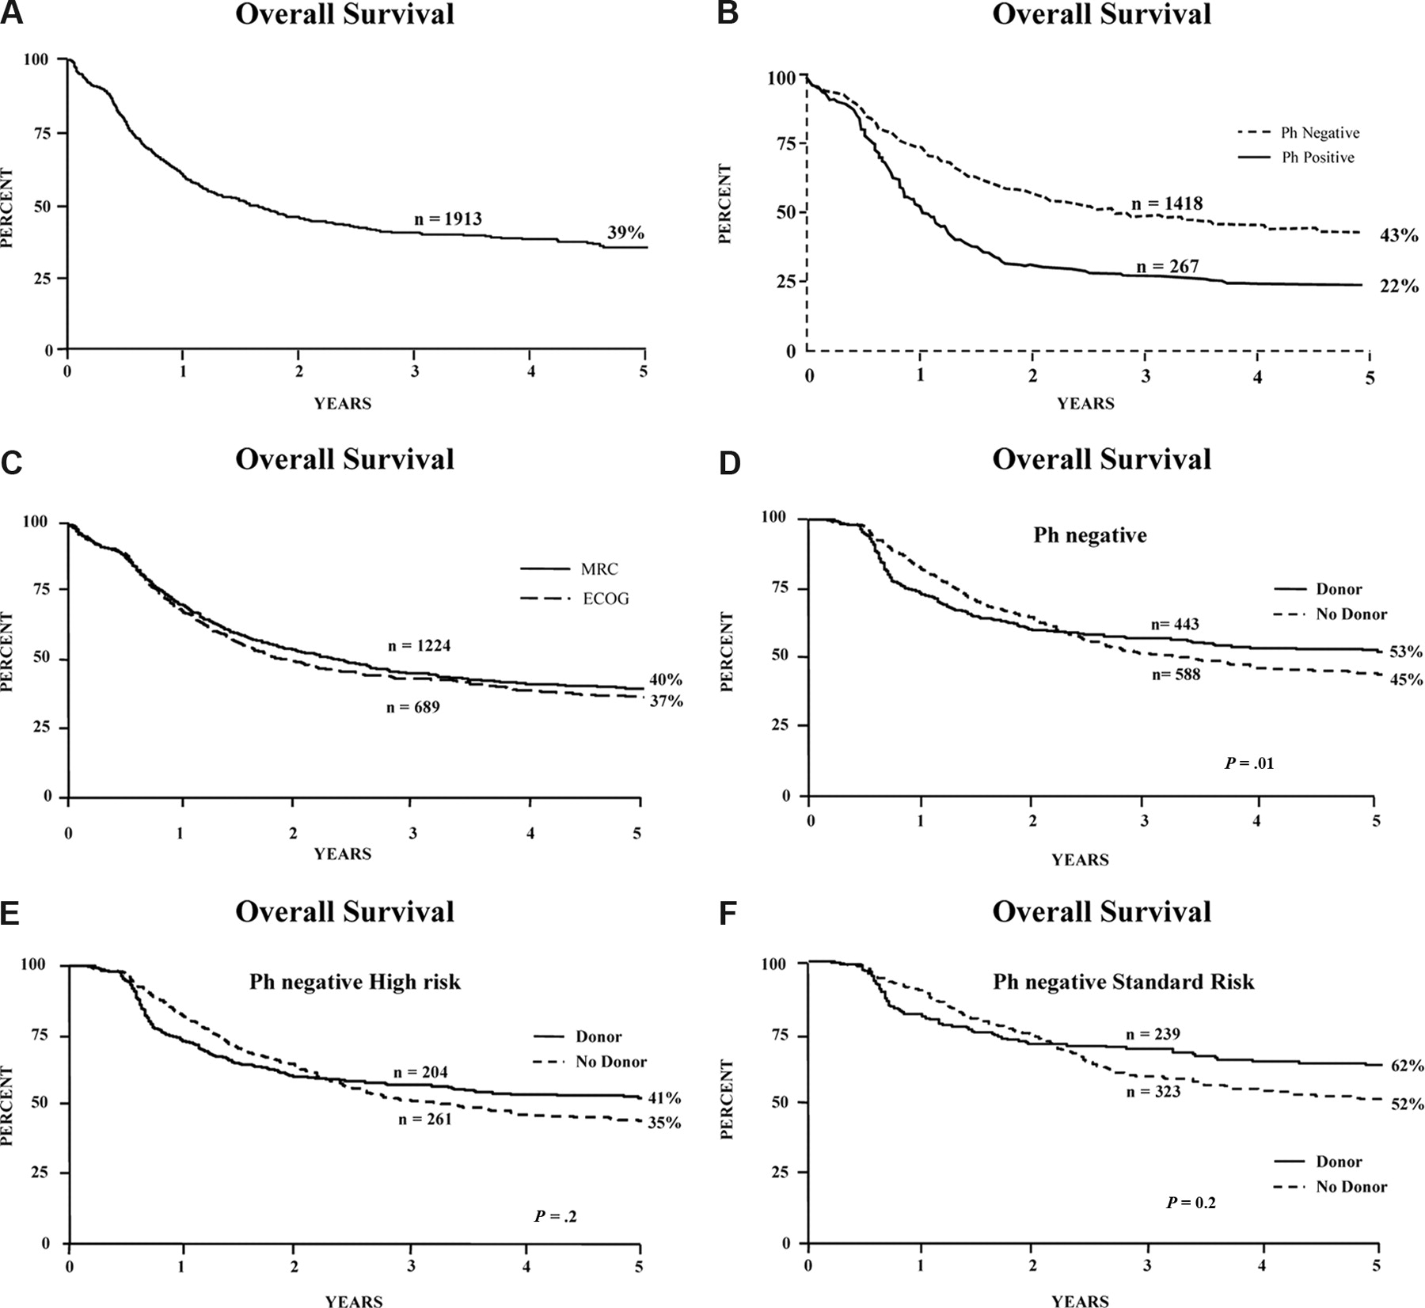
Role of alloHSCT in adult ALL (CR1): better outcome in patients with a matched-related donor (MRC UKALL XII/ECOG E2993)
Goldstone et al, 2008

Slide 17
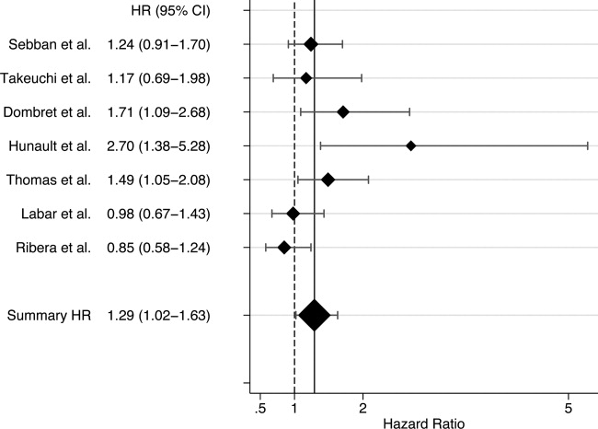
Role of alloHSCT for adult ALL in CR1: a meta-analysis of prospective trials
Yanada et al, 2006

Slide 18
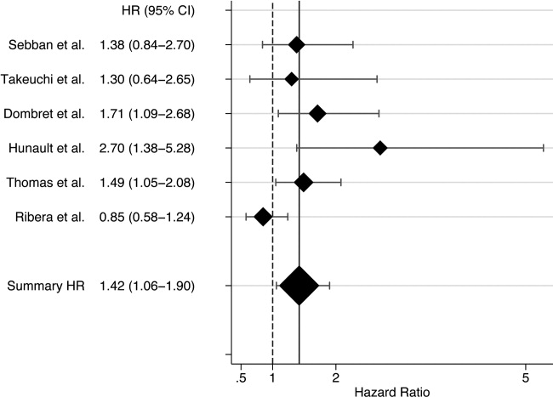
Role of alloHSCT for adult ALL in CR1:
high-risk patients
Yanada et al, 2006

Slide 19
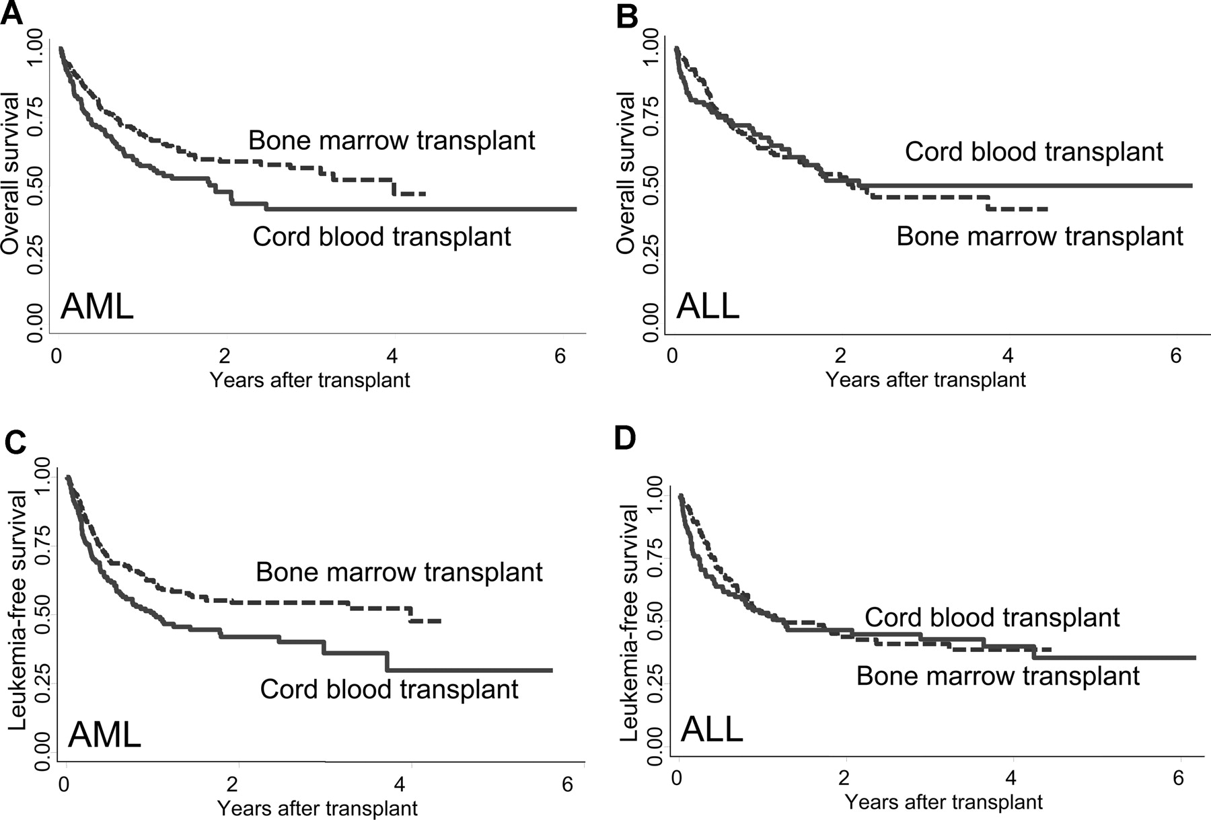
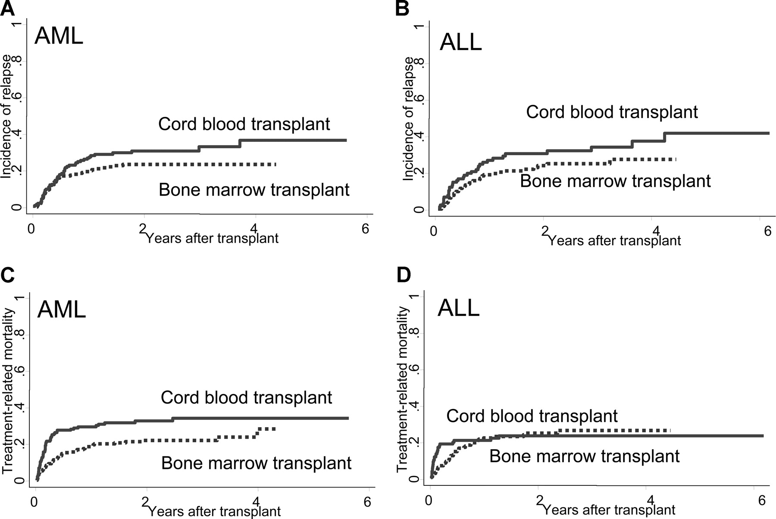
TPH DNE. SCU frente a MO
Atsuta et al. Blood 2009

Slide 20
Results of non-myeloablative SCT in adult ALL
Author Year Age N OS REL TRM
(med) ALL CCR
Martino et al 2003 50 27 31% 49% 23%
Arnold et al 2002 38 22 18% 36% 41%
Gutierrez et al 2007 19 43CR2 30% nr 21%
Hamaki et al 2005 55 43 40%1y 50% 30%
Mohty et al (EBMT) 2008 38 97 31%2y 51% 28%
TOTAL 232 31% 49% 28%

Slide 21
RIC vs. mieloablativo en LAL adulto
(pacientes >45 a., registro EBMT)
RIC Mieloabl. P
N 97 601
Edad mediana 56 50 0,0001
SP 88% 58% 0,001
EICHa II-IV 35% 28% NS
EICHa III-IV 14% 10% NS
NRM a 2a. 22% 32% 0,04
Prob. Recaída 2a. 42% 30% 0,0007
Prob. SLE 2a* 37% 38% 0,42
*Unico factor pronóstico: estado LAL al TPH
Mothy M, 2008

Slide 22
TPH LAL adulto. Indicaciones actuales
Fase y subtipo Alo DE Alo DNE Auto
RC-1
- Adultos jóvenes RE No No No
- Riesgo elevado Si Si No
- LAL Ph+ Si* Si* No
- LAL-B madura No No No
- LAL edad avanzada ¿AIR? ¿AIR? No
RC>1 Si Si No

Slide 23
Risk-adapted therapy in T-ALL: proposed strategy according to molecularly defined subgroups
Risk group | Post-remission tx
Thymic T-ALL with favorable markers Absence of HOX11L2 (TLX3) expression Low BAALC/ERG expression HOX11 (TLX1) high | CT-based
Thymic T-ALL with unfavorable markers HOX11L2 (TLX3) expression High BAALC or ERG expression Early T-ALL Mature T – ALL | AlloHCT in CR1?

Slide 24
Will MRD negativity stop more allografts?
Bassan R, et al. Blood 2009; 113: 4153-4162
JM Ribera et al, ASH 2009, oral presentation

Slide 25
LAL Ph+

Slide 26
Quimioterapia
+
Inhibidores de tirosincinasa de ABL
+
Trasplante alogénico de progenitores hematopoyéticos
LAL Ph (BCR-ABL) en pacientes jóvenes

Slide 27
Approved substances and pipeline
ATP-Binding |  | T315I-Active | Nonkinase Inhibition
Bcr-Abl | Abl & Src
Imatinib | Dasatinib | MK-0457 | 17-AAG
Nilotinib | Bosutinib | KW-2449 | HDAC
 | INNO-406 | XL228 | DAC
 |  | AT9283 | HHT
 |  | PHA-739358

Slide 28
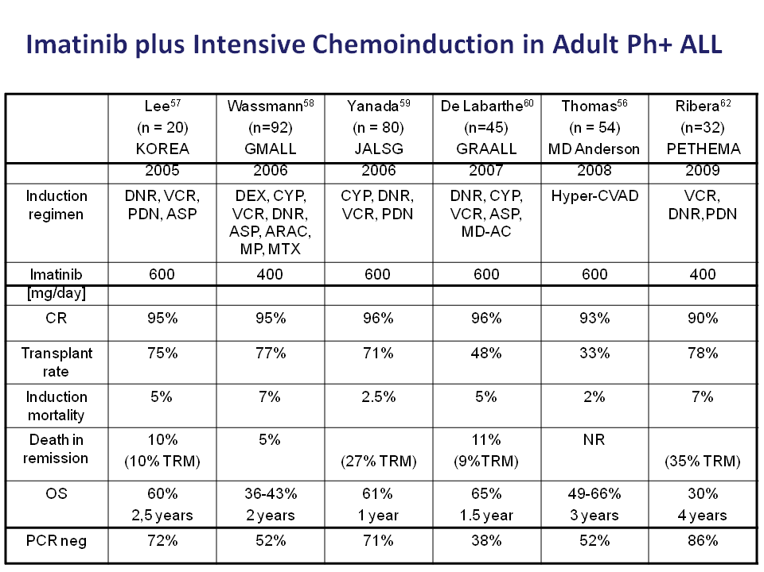

Slide 29
Modalidades de combinaciones
a
Imatinib
Quimioterapia
b
Trasplante
c
d
Notes:
El gen abl, que se extiende desde el exon 2 hasta el exon 11 en el cromosoma 9, codifica para la tirosinquinasa nativa (145 kDa). La quinasa Abl salvaje (o c-abl) tiene una actividad normal de transducción de señales en una célula no maligna.
Durante la translocación entre cromosomas 9 y 22, el punto de rotura en el fragmento del gen c-abl suele ocurrir a 5' del exon 2. En contraste, el lugar del punto de rotura del gen bcr puede variar (p.ej, entre exones b1 y b2, b3, ó b4), dando como resultado genes de fusión productos de diferentes tamaños que, a su vez, codifican para tirosinquinasas de proteínas de fusión de diferentes masas moleculares: 185/190 kDa, 210 kDa, y 230 kDa (no mostrada), todas con actividad tirosinquinasa.
La porción Bcr de la proteína interfiere con el componente reguladora de la actividad quinasa de la c-Abl, dando lugar a una activación constitutiva de la actividad quinasa.
La tirosinquinasa de la proteína de fusión p210Bcr-Abl se expresa principalmente en la LMC, la p190Bcr-Abl principalmente en la LLA Ph+, y la p230Bcr-Abl en un subgrupo de pacientes con LMC.
Melo JV. The diversity of BCR-ABL fusion proteins and their relationship to leukemia phenotype. Blood. 1996;88:2375-2384.
Pasternak G, Hochhaus A, Schultheis B, Hehlmann R. Chronic myelogenous leukemia: molecular and cellular aspects. J Cancer Res Clin Oncol. 1998;124:643-660.

Slide 30
Aprobación de imatinib para
el tratamiento de pacientes
adultos con LAL Ph+
de diagnóstico reciente,
integrado con quimioterapia

Slide 31
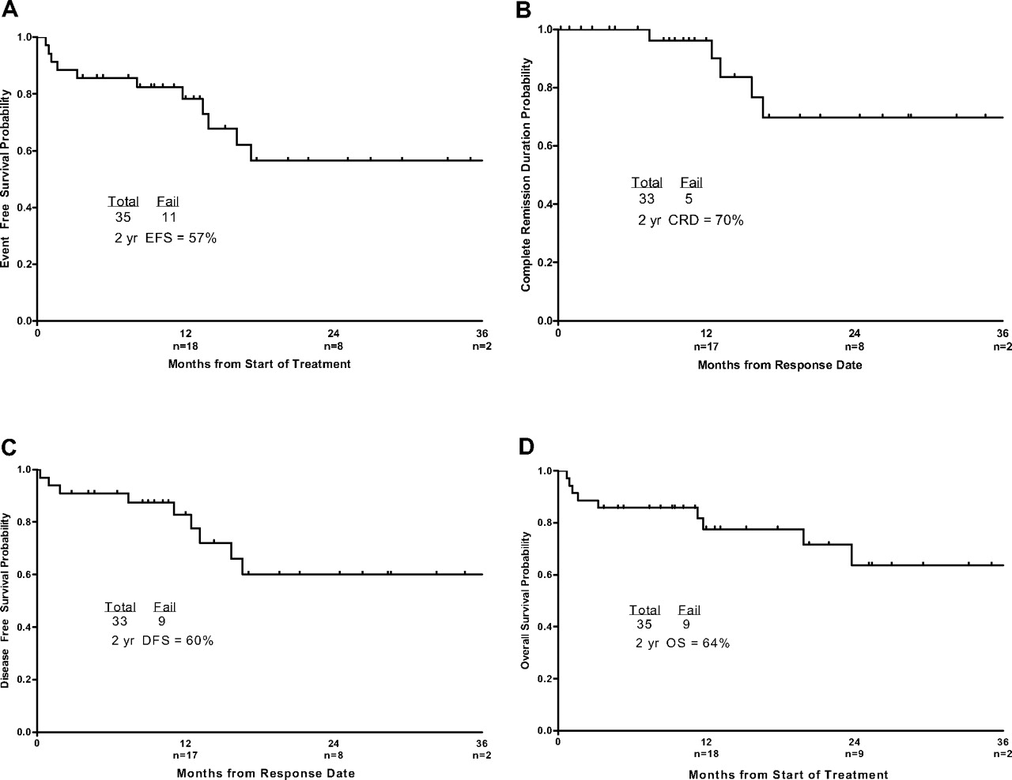
Dasatinib +HyperCVAD
EFS, CR duration, DFS, and OS.
Ravandi F et al. Blood 2010;116:2070-2077
Notes:
Event-free survival, CR duration, DFS, and overall survival of the patients. (A) Event-free survival, (B) CR duration, (C) DFS, and (D) overall survival. Numbers of patients at risk are indicated on the horizontal axis.

Slide 32
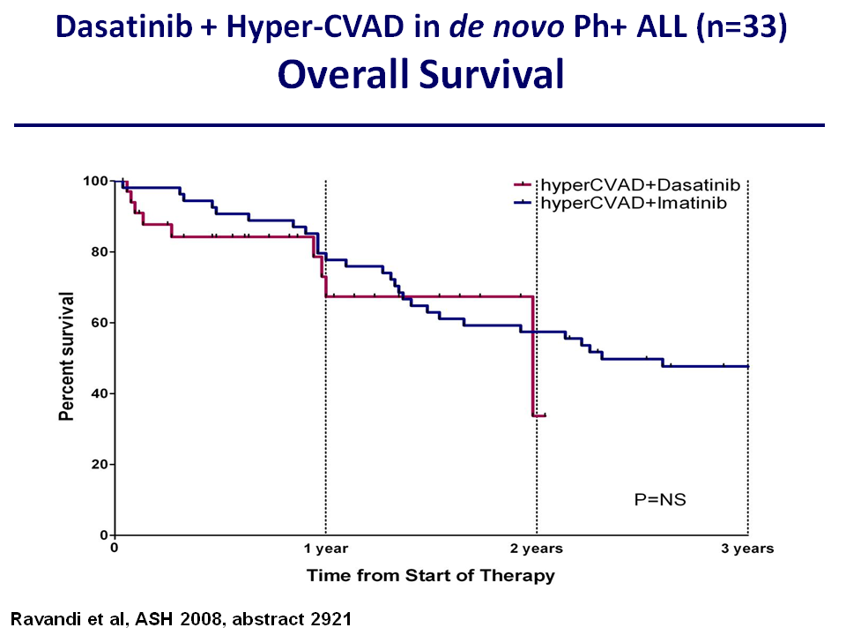

Slide 33
LAL Ph+: Imatinib. Estudios aleatorizados
I-800-VD
LAL Ph+
15-60a
R
Alo-TPH (o auto TPH si no donante
y ERM <0,1%)
I-800-HiperCVAD
I-VD I-HiperCVAD p
N 42 41 n.s.
RC (%) 100 95 n.s
ERM <0,1% fin inducc (%) 35 45 n.s
ERM <0.1% fin consol (%) 48 72 0,05
SG 2 a (%) 68 54 n.s.
SLE 2 a (%) 54 32 n.s.
Mensaje: Intensificación QT asociada a imatinib mejora la ERM pero no tiene
influencia en duración RC. La toxicidad pre-TPH es alta en brazo de QT intensiva
#12. Chalandon Y, et al. First Results of the GRAAPH-2005 Study in younger Adult Patients with De Novo
Philadelphia Positive Acute Lymphoblastic Leukemia. ASH 2008
Notes:
33

Slide 34
Ph+ ALL < 55 yr. ALL Ph-08
ALL, < 55yr
Pre-phase
Ph+ ALL
Induction (I-600)
Consolidation-1
Donor
No donor/No allo SCT feasible
Allo SCT
Auto-SCT
MRD-
MRD+
Imatinib+MP+MTX
(up to 2-yr)
Follow-up
Imatinib*
*Except T315I mutation

Slide 35
LAL-PH-08
Registrados 23, 13 centros
Faltan datos : 1
Válidos 22, (97%)
RC 22, (100%)
Pte. inicio consolidación : 1
Consolidación : 21
En tratamiento : 4
Fin consolidación : 4
Alo TPH: 13
Hermano HLA-id : 3
DNE : 3
TSCU : 7
AutoTPH (No donante HLA-id. o imposibilidad AloTPH): 0
Recaída m.o. : 3
Exitus : 1
RCC : 9
Notes:
35

